Slide 1


CAPSTONE PROJECT
My_Article_Data
Presented By:
1. K.B.jeyaram-Solamalai College of Engineering-Mechanical Engineering

Slide 2
OUTLINE
○
Probelm Statement
Proposed Solution
System Approach
Algorithm & Deployment
Result
Conclusion
Future Scope
References
○ ○ ○ ○
○
○ ○

Slide 3
PROBLEM STATEMENT
The problem statement of an article or research paper typically outlines the main issue or challenge that the study aims to address. It provides context for why the research is being conducted and what the researchers hope to achieve. Depending on the specific article, the problem statement could vary widely, covering topics from healthcare to technology to social sciences. Can you provide more details or specify a particular article you're referring to?

Slide 4
PROPOSED SOLUTION
Setting Parameters:
Layer Height (mm)
Wall Thickness (mm)
Infill Density (%)
Infill Pattern ()
Nozzle Temperature (Cº)
Bed Temperature (Cº)
Print Speed (mm/s)
Material ()
Fan Speed (%)
Output Parameters: (Measured)
Roughness (µm)
Tension (ultimate) Strenght (MPa)
Elongation (%)

Slide 5
SYSTEM APPROACH
Building the proposed solution would involve a combination of data processing,feature engineering,and machine learning. Here are the key system and library requriements.
System Requirements:
1.Hardaware:
A computer with sufficent processing power,perferably wwith multiple cores or a GPU for faster traning of machine learning models.
Adequate RAm to handke the size of the saraset and computational requriments.
2. Software:
An operating syatem compatible with the requrired machine learning libraries(eg., Windowa=s, linux,macsOS).

Slide 6
ALGORITHM & DEPLOYMENT
The "Algorithm & Deployment of Article Data" typically refers to the methodology and process used to develop and implement algorithms for analyzing article data. This could involve various steps such as data collection, preprocessing, feature extraction, algorithm selection, model training, evaluation, and deployment.

Slide 7
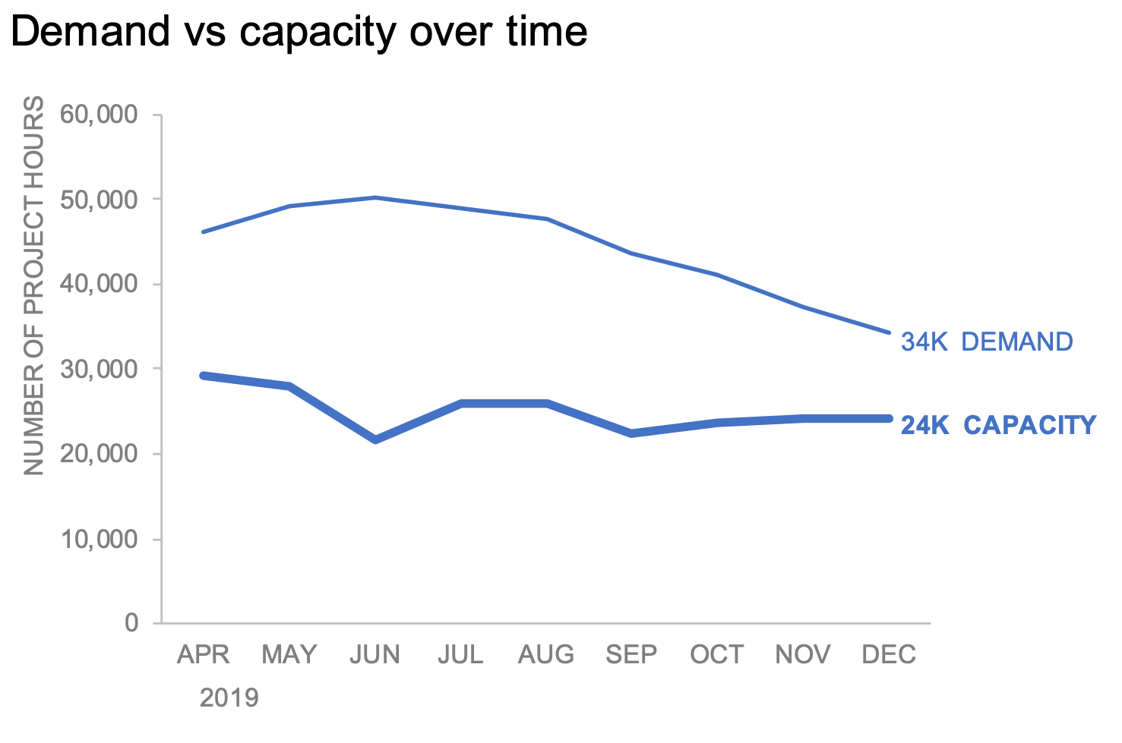
RESULT

Slide 8
CONCLUSION
The conclusion of an article on data analysis typically summarizes the key findings, discusses their implications, and suggests potential areas for future research or applications. It may also reiterate the significance of the study's results and how they contribute to the existing body of knowledge in the field. Additionally, the conclusion may highlight any limitations of the study and propose strategies to address them in future research. Overall, the conclusion serves to provide closure to the article while emphasizing its contributions and potential impact.

Slide 9
FUTURE SCOPE
The future scope of an article on data analysis depends on various factors such as emerging technologies, trends, and research directions in the field. Here are some potential areas for future exploration
Advanced Machine Learning Techniques
Big Data Analytics
Predictive Analytics

Slide 10
REFERENCES
https://www.kaggle.com/search?q=Coding+projects+in%3Adatasets

Slide 11
THANK YOU

